Slide 1
EmpowHERed Campaign
www.threadsforteens.org/empowhered-campaign | reed@threadsforteens.org

Slide 2
Details
Launch Date: 3rd August 2015
Avenues: Instagram, YouTube
Who: Spread across social media by selected influencers
All influencers will receive a small EmpowHERed Campaign gift!
www.threadsforteens.org/empowhered-campaign | reed@threadsforteens.org

Slide 3
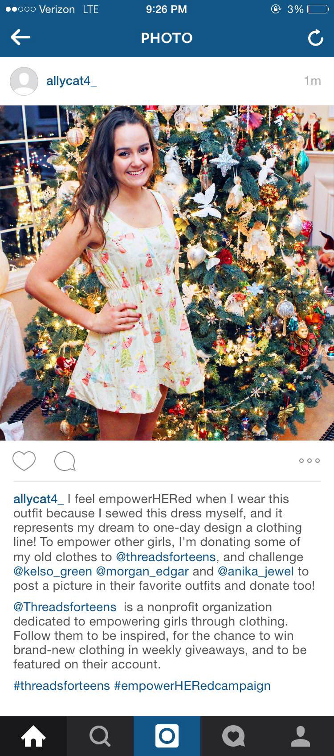
www.threadsforteens.org/empowhered-campaign | reed@threadsforteens.org

Slide 4
Key elements of a post
I feel empowHERed when…
Challenging three friends
Tagging @threadsforteens
#threadsforteens
#empowHERedcampaign
www.threadsforteens.org/empowhered-campaign | reed@threadsforteens.org

Slide 5
Sample Text -- Instagram
I feel empowerHERed when I wear this outfit because I sewed this dress myself, and it represents my dream to one-day design a clothing line! To empower other girls, I'm donating some of my old clothes to @threadsforteens, and challenge @kelso_green @morgan_edgar and @anika_jewel to post a picture in their favorite outfits and donate to @threadsforteens!
You too can join the campaign by posting a picture in an outfit you rock and tagging three friends to do the same!!
Threads for Teens is a nonprofit organization dedicated to empowering girls through clothing. Follow them to be inspired, for the chance to win brand-new clothing in weekly giveaways, and to be featured on their account.
#threadsforteens #empowerHERedcampaign
www.threadsforteens.org/empowhered-campaign | reed@threadsforteens.org

Slide 6
YouTube Tag
Why do you feel empowHERed when you wear this outfit?
Who empowHERs you?
What is your favorite piece of clothing you own?
What is your current dream?
Why do you think it is important to wear clothes you love?
What will you donate to Threads for Teens?
www.threadsforteens.org/empowhered-campaign | reed@threadsforteens.org

Slide 7
Mailing Address for Donations
Threads for Teens
5129 Oak Meadow Drive
Santa Rosa, CA 95401
Threads for Teens Tax ID Number: 90-0733578
www.threadsforteens.org/empowhered-campaign | reed@threadsforteens.org

